Slide 1

BISUTEX LTDA.
BY:
CAMILO ANDRÉS BARRAGÁN
EVELYN GABRIELA GARCÍA BRACHO
MELANY FERNANDA OSPINA CALVO
BRENDA SOFÍA RAMÍREZ ZÁRATE

Slide 2
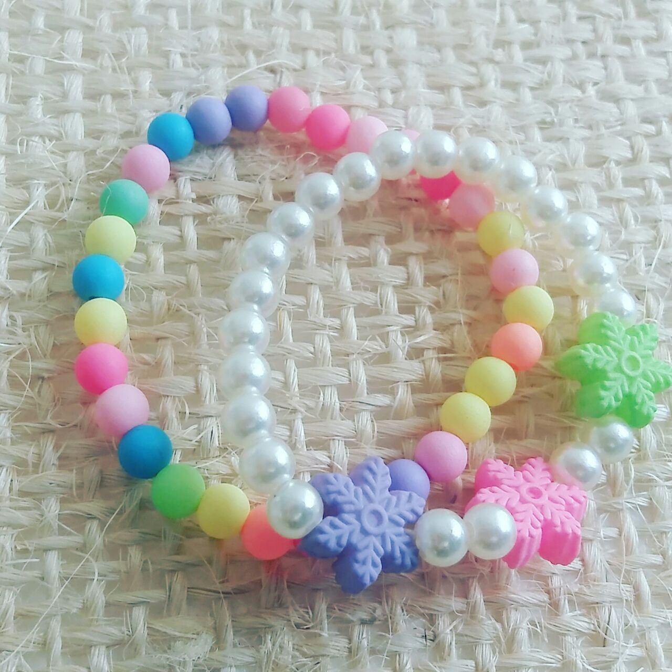
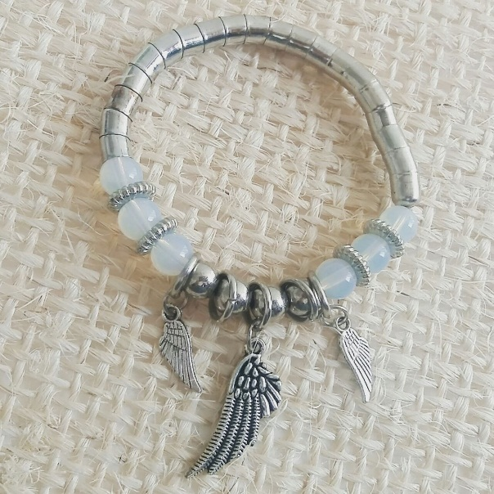

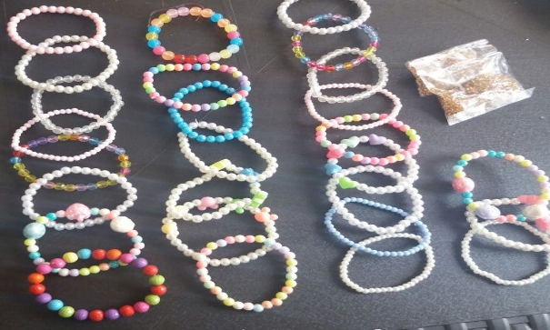
WHAT´S BISUTEX LTDA?
IMITATION JEWELRY

Slide 3
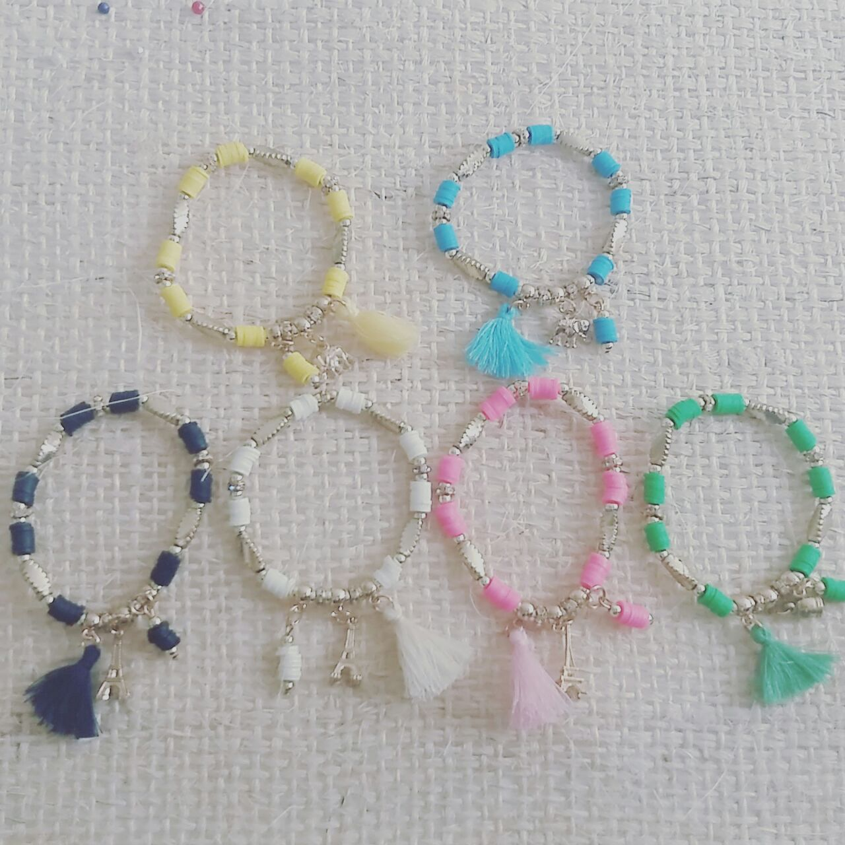

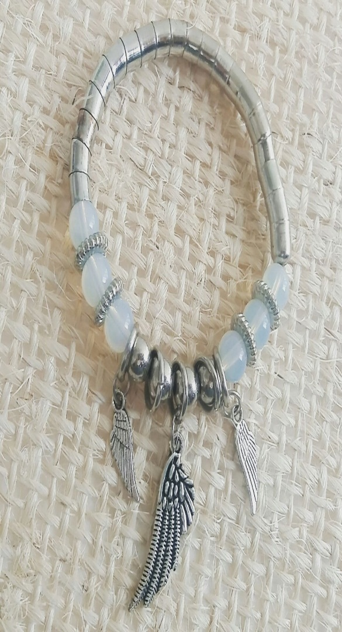
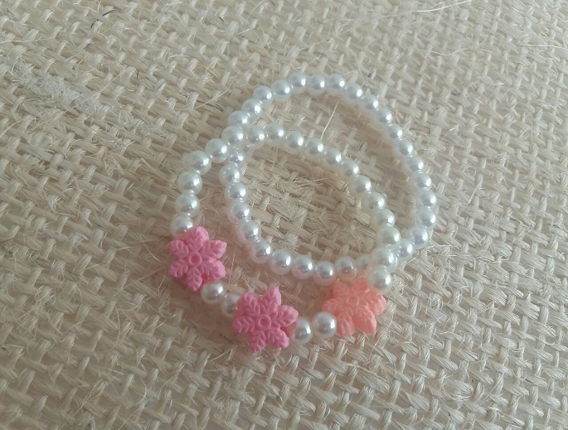
Principal activity
JEWELRY MANUFACTURE

Slide 4

LOGO

Slide 5
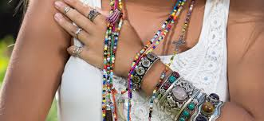
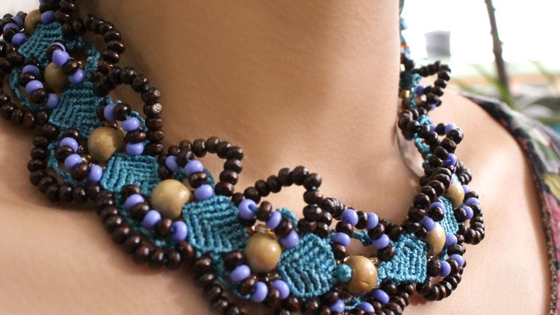
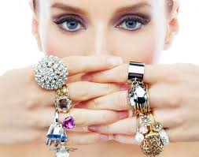
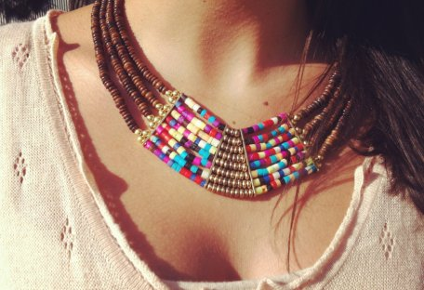

SLOGAN
INNOVA TU ESTILO // INNOVATE YOUR STYLE

Slide 6



THE VISION OF THE COMPANY
REGIONAL POSITIONING
INCREASE

Slide 7





Mission of the company

Slide 8






why DID we create the company?

